Slide 1


Thomas Freeman
24th April 2022

Slide 2

Outline
Executive Summary
Introduction
Methodology
Results
Conclusion
Appendix

Slide 3
Executive Summary
Summary of methodologies
Data Collection via API
Data Collection using Web Scraping
Data Wrangling
Exploratory Data Analysis with Data Visualization
Exploratory Data Analysis with SQL
Interactive Maps with Folium
Dashboard Analytics with Plotly Dash
Predictive Analytics via Classification Machine Learning
Summary of all results
Exploratory data analysis results
Interactive analytics demo in screenshots
Predictive analysis results

Slide 4
Introduction
Project background and context
Space X is a multi-billion-dollar aerospace company founded by Elon Musk in 2002 to revitalize public interest in the exploration of space, manufacturing rockets affordably. Such affordability is a result of unique design features that enable Space X’s falcon 9 rockets to reuse their first stage. Understanding whether the recycling of the first stage lands successfully can help to determine the cost of launch. Hence in the knowledge of such cost-related-benefit, this gives a company the opportunity to be competitive.
Therefore, the objective of this project is to determine the price of each launch via the use of data gathering, data visualization and machine learning to predict landing success.
Problems you want to find answers
What variables influence the success of a rocket landing?
What are the ideal requirements necessary to enable a successful landing program?
What is the most appropriate classification model and it’s optimal hyperparameters?

Slide 5

Section 1

Slide 6
Methodology
Executive Summary
Data collection methodology:
The data collection method for the project used both the SpaceX API, and web scraping from Wikipedia.
Perform data wrangling
To understand variables in greater detail the method value_counts() with the creation of a dataframe to display successes and failures as a binary outcome and show the overall success rate.
Perform exploratory data analysis (EDA) using visualization and SQL
One-hot encoding was applied to categorical attributes.
Perform interactive visual analytics using Folium and Plotly Dash
Perform predictive analysis using classification models
How to build, tune, evaluate classification models

Slide 7
Data Collection
The SpaceX Data used with the project has been via multiple methods
Data was collected by means of a get request to the SpaceX API
Then to make the requested JSON results more consistent, a static response object was used
Subsequently, the response content was decoded as a Json using the .json() function and transformed into a Pandas dataframe using .json_normalize()
The data was then filtered to keep Falcon 9 launches only; the sequential flight number was reset, and missing Pay Load Mass values were identified and replaced with its mean column value in order to clean the data
Additionally, web scraping using BeautifulSoup was implemented on a Wikipedia webpage holding details of Falcon 9 launches
Finally, the extracted HTML table launch records were parsed and converted into a Pandas dataframe

Slide 8
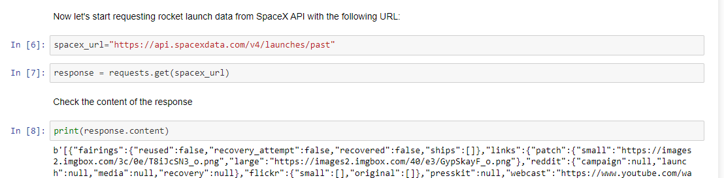
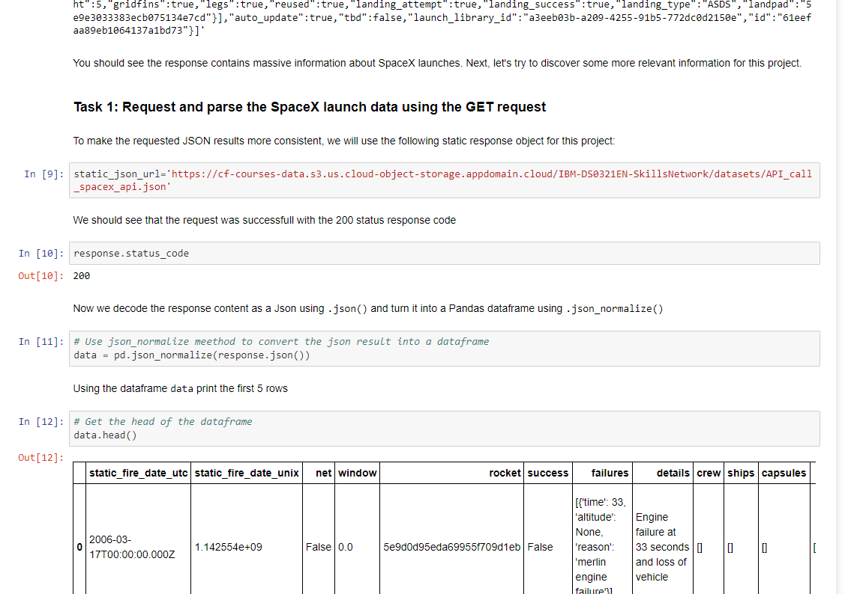
Data Collection – SpaceX API
A get request was implemented to the SpaceX API to retrieve the data. Subsequently cleansing and wrangling was applied to the data to, filter, re-format, identify and replace missing values with a calculated mean.
The link to the Notebook can be see below: https://github.com/FreeTheFreeman/IBMAppliedDataScienceCapstone/blob/master/SpaceX%20Lab:%20Data%20Collection%20%26%20Wrangling.ipynb

Slide 9
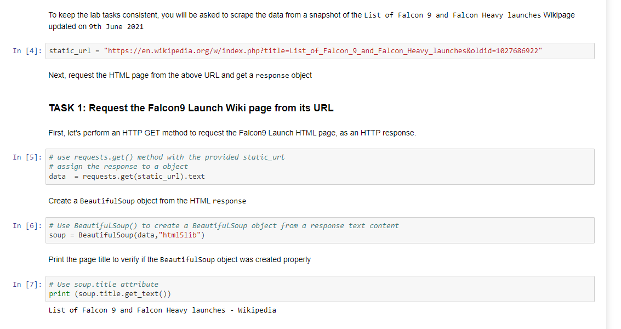
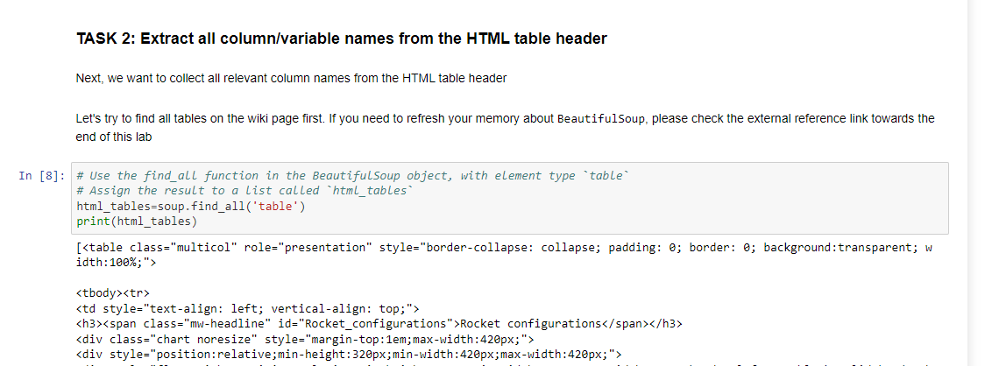
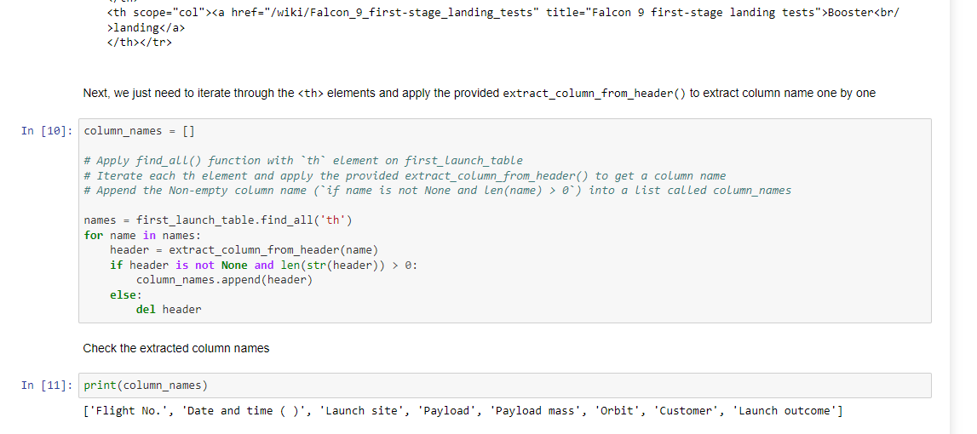
Data Collection - Scraping
An additional method of data collection was used, specifically Web Scraping. Falcon 9 launch records were scraped from Wikipedia via BeautifulSoup. The table was then parsed and converted into a pandas dataframe.
The link to the Notebook can be see below: https://github.com/FreeTheFreeman/IBMAppliedDataScienceCapstone/blob/master/SpaceX%20Lab:%20Web%20Scraping.ipynb

Slide 10
Data Wrangling
Firstly, missing values were identified, and the percentage of missing values was calculated for each attribute, and numerical and categorical columns were identified.
Subsequently, the method value_counts() was used on the LaunchSite column, Orbit column, and Outcome column to determine the number of launches on each site, the occurrence of each orbit, and the number of landing_outcomes respectively.
A Class dataframe was determined from an outcome array, created using an np.where clause that used a list of bad outcomes to attribute a binary outcome.
Finally, the overall success rate was determined to be 66% via the .mean() function.
The link to the Notebook can be see below: https://github.com/FreeTheFreeman/IBMAppliedDataScienceCapstone/blob/master/SpaceX%20Lab:%20Exploratory%20Data%20Analysis.ipynb

Slide 11
EDA with Data Visualization
For the exploration of the data, visualizations of the relationships between Flight Number and Launch Site, Payload Mass and Launch Site, Flight Number and Orbit Type, and Payload Mass and Orbit Type were displayed as scatter charts.
Furthermore, the Success Rate for each orbit type was displayed as a bar chart, and a yearly time series of success rates displayed a trend by means of a line graph.
Feature engineering was also implemented to specific columns of the dataframe via the use of OneHotEncoding in the form of the get_dummies function. Then all numeric columns were cast to the type float64.
The link to the Notebook can be see below: https://github.com/FreeTheFreeman/IBMAppliedDataScienceCapstone/blob/master/SpaceX%20Lab:%20Exploratory%20Data%20Analysis.ipynb

Slide 12
EDA with SQL
The SQL queries performed displayed:
the names of the unique launch sites
5 records where the launch sites began with 'CCA’
the total payload mass carried by boosters launched by NASA (CRS)
the average payload mass carried by booster version F9 v1.1
The SQL queries also listed:
the date when the first successful landing outcome happed in ground pad
the names of the boosters which had success in drone ship for payload mass greater than 4000 but less than 6000
the total number of successful and failed mission outcomes
the names of the booster_versions which carried the maximum payload mass
the failed landing_outcomes in drone ship, their booster versions, and launch site names for in year 2015
Furthermore, the SQL query ranked the count of landing outcomes between the date 2010-06-04 and 2017-03-20, in descending order
The link to the Notebook can be see below: https://github.com/FreeTheFreeman/IBMAppliedDataScienceCapstone/blob/master/SpaceX%20Lab:%20EDA%20with%20SQL.ipynb

Slide 13
Build an Interactive Map with Folium
The interactive map using folium marked all launch sites on a map and added success and failed launches for each site with the use of markers and circles.
The class was used to determine the color of a marker for each launch depending on whether the launch was successful or not, such that green was assigned to class 1 for a success, and red to class 0 to represent a failed launch.
The distances between a launch site to its proximities were calculated, specifically the proximity of a specific launch site to the nearest coastline, nearest railway, nearest highway road and nearest city.
This was all in order to determine the closeness of proximity to these locations and to understand whether launch site keep a specific distance away from cities.
The link to the Notebook can be see below: https://github.com/FreeTheFreeman/IBMAppliedDataScienceCapstone/blob/master/SpaceX%20Lab:%20Visualisations%20with%20Folium.ipynb

Slide 14
Build a Dashboard with Plotly Dash
The interactive dashboard was built using Plotly Dash
A pie chart is displayed as the first chart on the dashboard showing the proportion of successful launches by site. This chart can be further interrogated to show the proportion of successes and failures per site via dropdown selection.
Another chart on the interactive dashboard was a scatterplot to show the Outcome versus Payload Mass for each Booster version. This included an interactive range slider to enable the changing of the Payload Mass axis.
The link to the Notebook can be see below: https://github.com/FreeTheFreeman/IBMAppliedDataScienceCapstone/blob/master/SpaceX%20Lab:%20Interactive%20Visualisations%20with%20Dash.ipynb

Slide 15
Predictive Analysis (Classification)
Firstly, a NumPy array from the column Class was created, by applying the method to_numpy() and assigning it to a variable
The data was then transformed by standardising it using StandardScalar() and subsequently split into Training and Testing Data sets via the use of test_train_split()
Then multiple machine learning models were constructed, including Logistic Regression, SVM, Decision Tree, and KNN; and each model was tuned using GridSearchCV for parameter optimisation.
Each model’s performance was assessed using the Accuracy metric on the Test data to inform which of the constructed and tuned models performed the best
Hence subsequently we found the best forming tuned machine learning model
The link to the Notebook can be see below: https://github.com/FreeTheFreeman/IBMAppliedDataScienceCapstone/blob/master/SpaceX%20Lab:%20Machine%20Learning.ipynb

Slide 16
Results
Exploratory data analysis results
Interactive analytics demo in screenshots
Predictive analysis results

Slide 17

Section 2

Slide 18
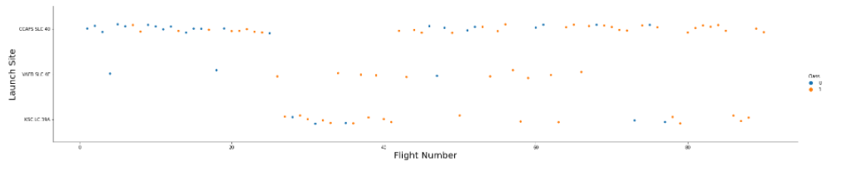
Flight Number vs. Launch Site
As shown in the screenshot below, 0 represents a failed launch and 1 represents a successful launch.
Generally, across all the launch sites as the flight number increases the number of successful launches increase.
Furthermore, the site with the greatest number of launches is CCAFS SLC-40 and the site with the smallest number of launches is KSC LC-39A.

Slide 19
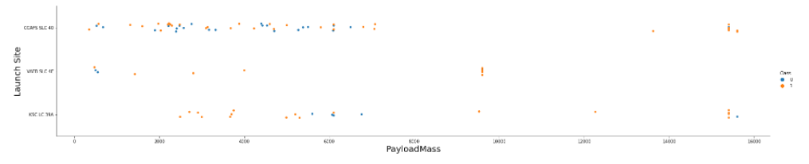
Payload vs. Launch Site
As shown in the screenshot below, 0 represents a failed launch and 1 represents a successful launch.
Generally, across all the launch sites as the Payload Mass increases the number of successful launches increase.
Furthermore, a significant majority of launches across all sights is successful for Payload Masses greater than 9000kg.

Slide 20
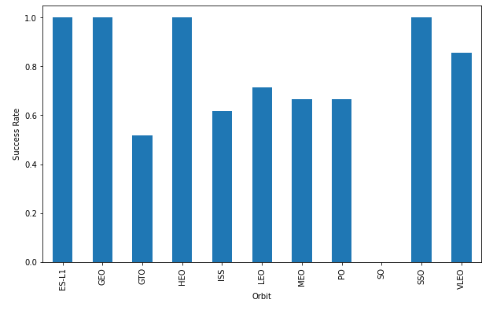
Success Rate vs. Orbit Type
As seen in the bar graph to the right of the side, the Orbit with the least successful orbit is GTO, whereas the orbits with the most success are ES-L1, GEO, HEO and SSO with 100% success rate.

Slide 21
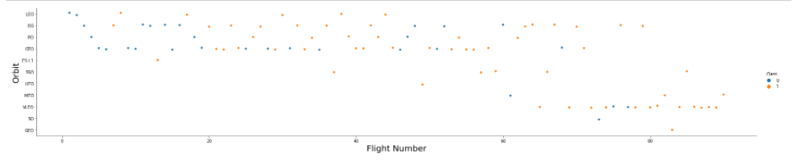
Flight Number vs. Orbit Type
As shown in the screenshot below, 0 represents a failed launch and 1 represents a successful launch.
As evident to in the graph, Success appears related to the number of flights for the LEO orbit. Whereas there seems to be no distinguishable relationship between flight number and success when in GTO orbit.

Slide 22
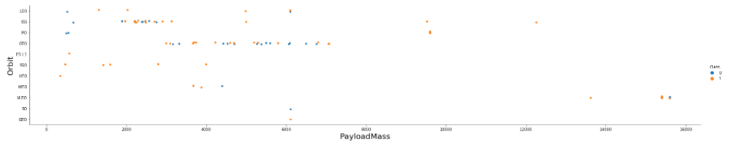
Payload vs. Orbit Type
As shown in the screenshot below, 0 represents a failed launch and 1 represents a successful launch.
As evident to in the graph, there is no evident relationship between successes as the Payload Mass increases for the GTO orbit.
For orbits LEO, ISS and Polar success increases with Payload Mass.

Slide 23
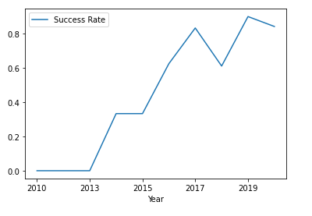
Launch Success Yearly Trend
The adjacent line graph shows for the first 3 years from 2010 there were no successes, yet the success rate has generally increased from 2013 onwards.

Slide 24
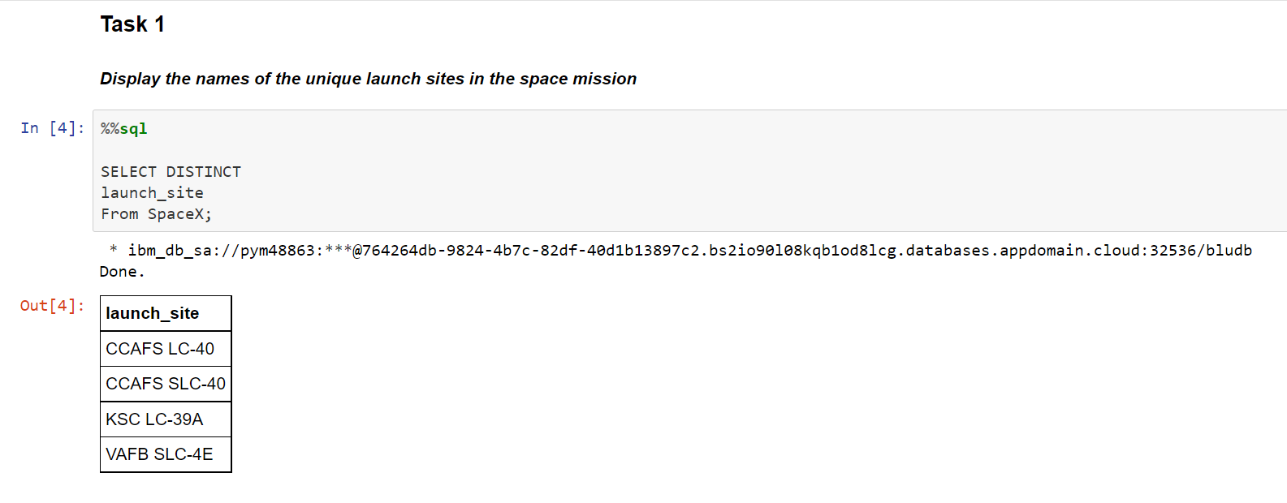
All Launch Site Names
The below screenshot displays the SQL code used to determine the unique Launch Sites used for the space missions and display the results as a table

Slide 25
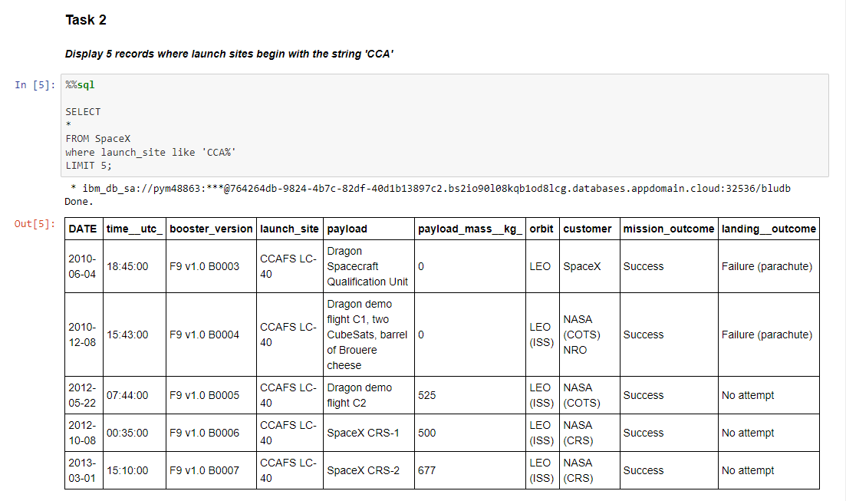
Launch Site Names Begin with 'CCA'
The below screenshot displays the SQL code used to show 5 records where the Launch Site begins with the character string ‘CCA’ and displays the results as a table

Slide 26
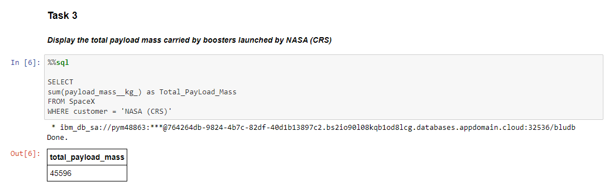
Total Payload Mass
The below screenshot displays the SQL code used to determine the Total Payload Mass launched by NASA (CRS) via the ‘sum()’ aggregate function and displays the result

Slide 27
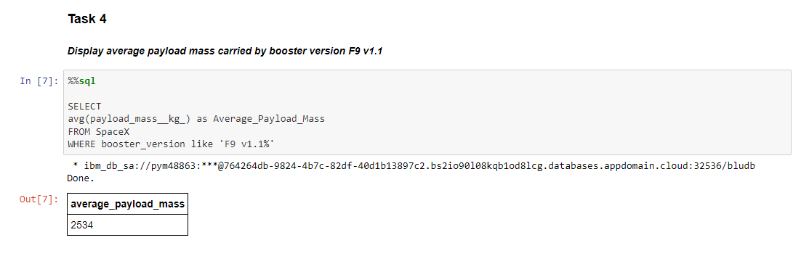
Average Payload Mass by F9 v1.1
The below screenshot displays the SQL code used to determine the Average Payload Mass launched for booster version F9 v1.1 via the ‘avg()’ aggregate function and displays the result

Slide 28
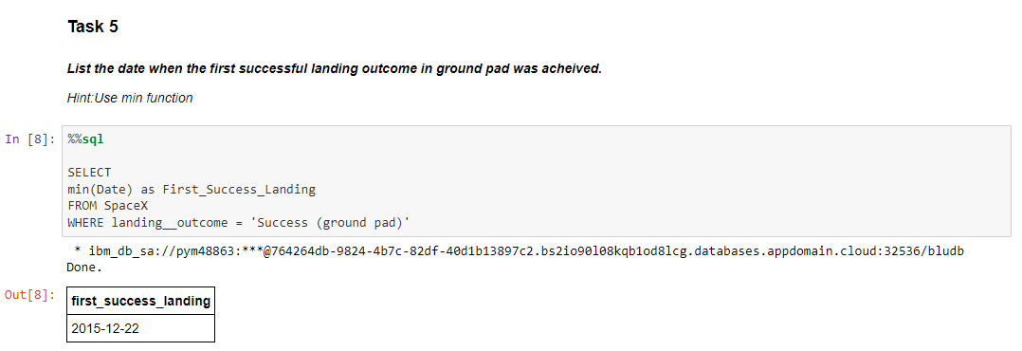
First Successful Ground Landing Date
The below screenshot displays the SQL code used to determine the date of the first successful ground landing via the use of the ‘min()’ aggregate function, and displays the result

Slide 29
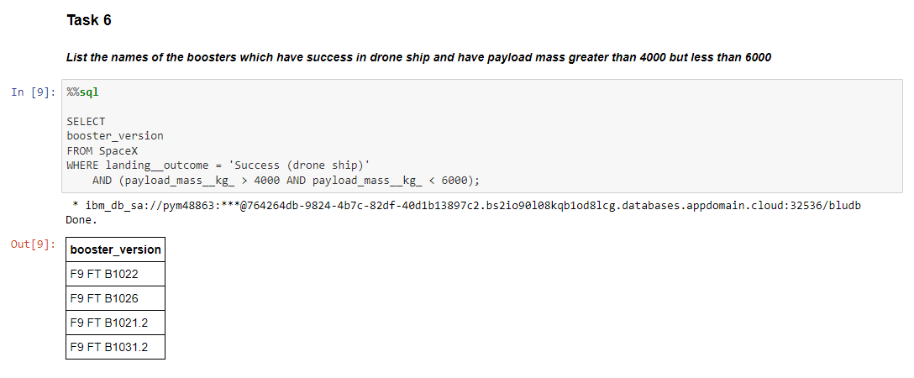
Successful Drone Ship Landing with Payload between 4000 and 6000
The below screenshot displays the SQL code used to determine the booster versions successfully landing on the drone ship with payloads between 4000 kg and 6000 kg, with use of a WHERE clause, and displays the result

Slide 30
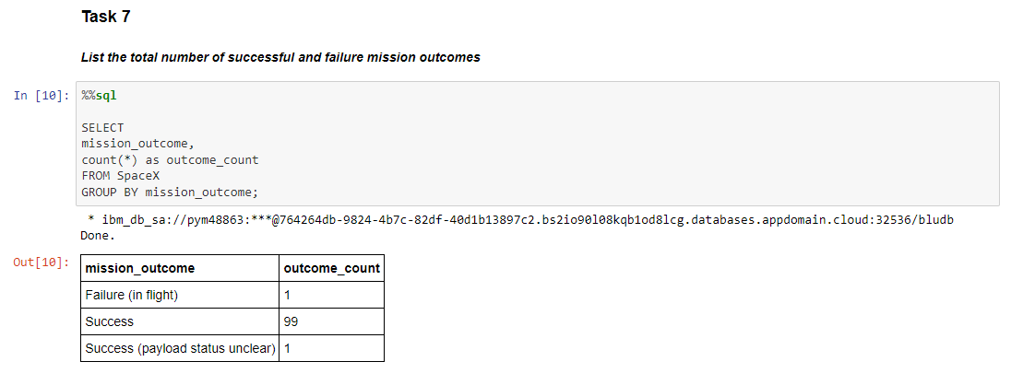
Total Number of Successful and Failure Mission Outcomes
The below screenshot displays the SQL code used to determine the total number of successful and failure mission outcomes with use of a ‘count()’ aggregate function and GROUP BY clause, and displays the result

Slide 31
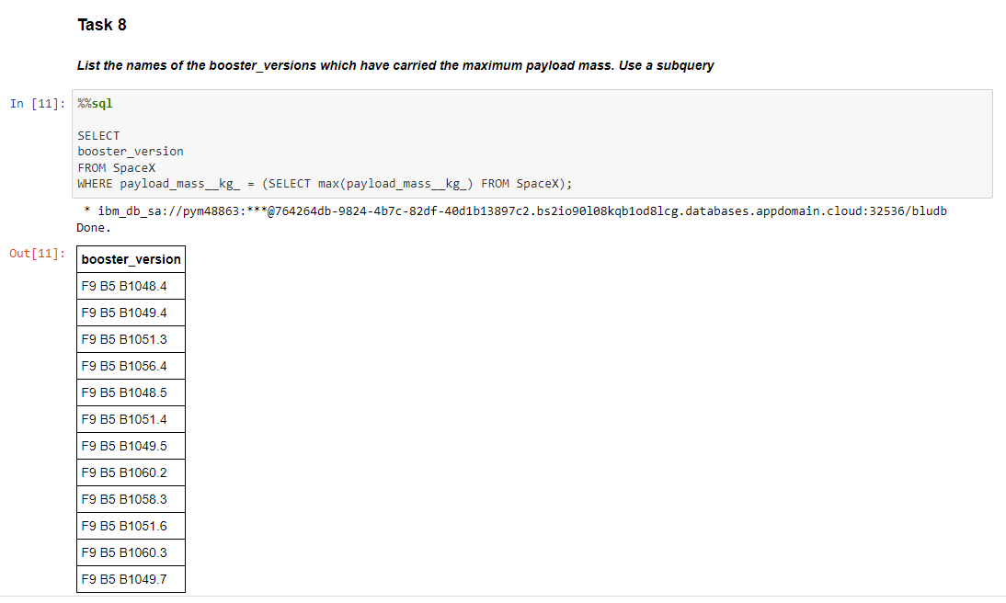
Boosters Carried Maximum Payload
The below screenshot displays the SQL code used to determine a list of the names of the Booster Versions which have carried the maximum payload mass, via the use of a subquery and ‘max()’ aggregate function within the WHERE clause, and displays the result

Slide 32
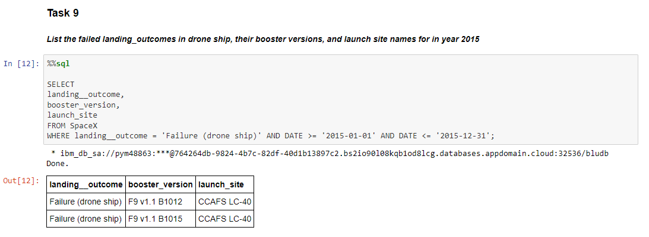
2015 Launch Records
The below screenshot displays the SQL code used to display the landing outcome, booster version and launch sites for failed drone ship landings in 2015, by use of a WHERE clause, and displays the result

Slide 33
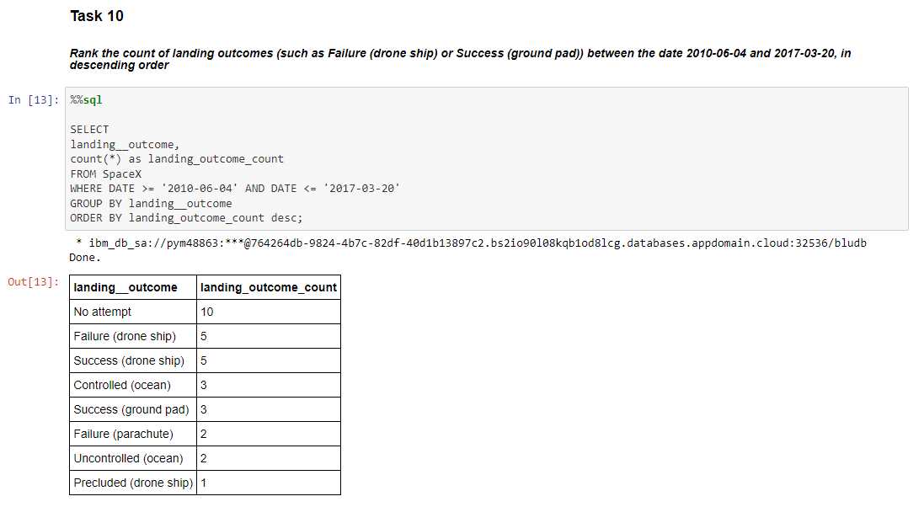
Rank Landing Outcomes Between 2010-06-04 and 2017-03-20
The adjacent screenshot displays the SQL code used to show the ranking of the count of landing outcomes between the dates 2010-06-04 and 2017-03-20, in descending order, by use of a ‘count()’ aggregate function and WHERE, GROUP BY, and ORDER BY clauses, and displays the result

Slide 34

Section 3

Slide 35
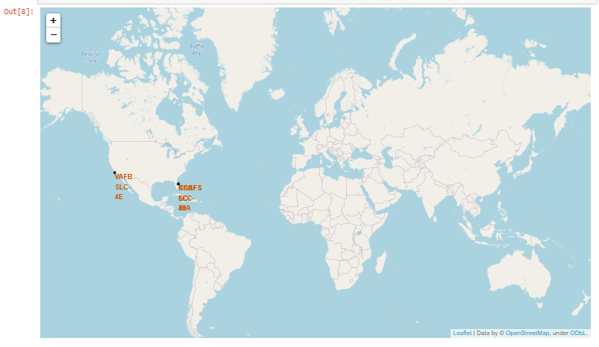
SpaceX Launch Sites
As evident from the adjacent map, it is seen that launch sites are on the coast of the United States, specifically in states California and Florida.

Slide 36
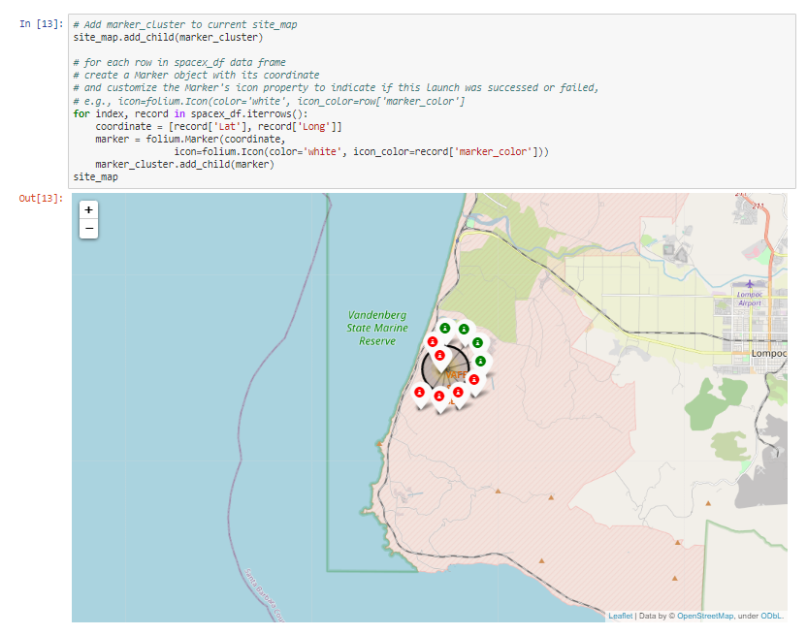
VAFB SLC-4E Launch Site Successes & Failures
The neighboring screenshot shows the California launch site and distinguishes between the successful and failed launches with green markers and red markers, respectively.
Out of the 10 launches at the California Launch site, 4 were successful and 6 failed.

Slide 37
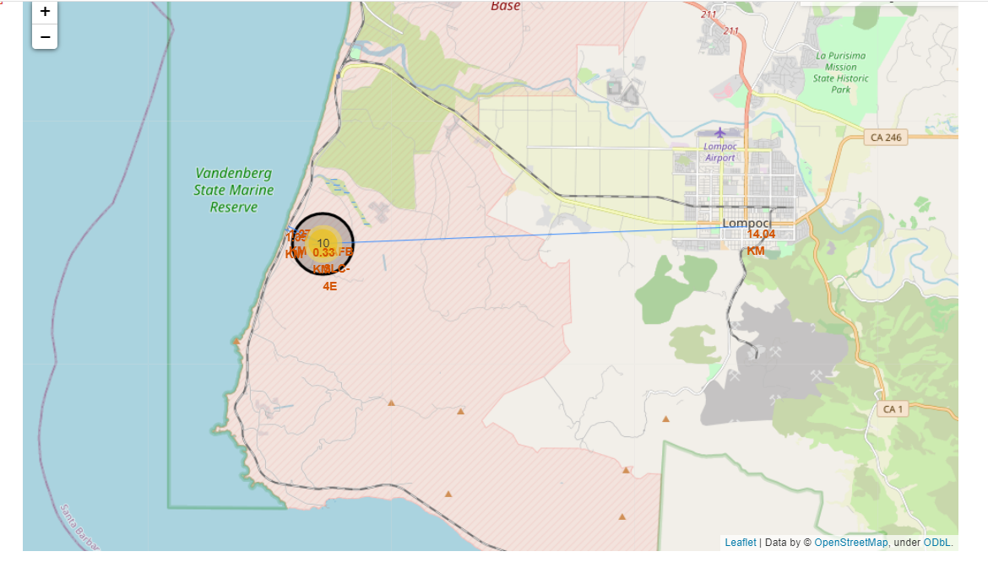
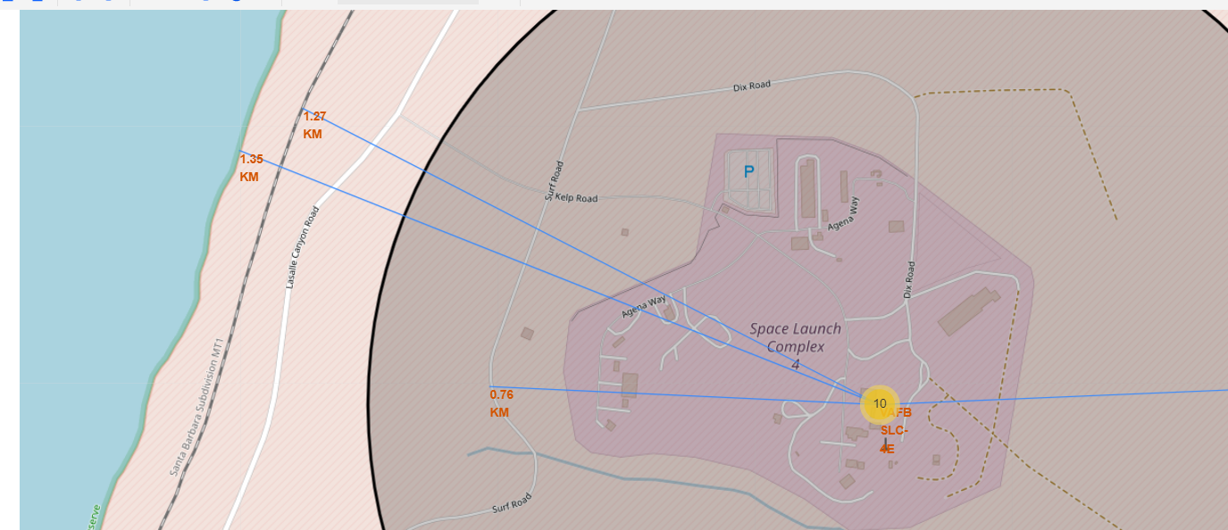
VAFB SLC-4E Launch Site Proximity to Geographical Markers
The top adjacent picture displays the distance in kilometers to the closest city which, as shown, is Lompoc and is 14km away from the VAFB SLC Launch site
The bottom adjacent picture displace the distance in kilometers to the closest highway, railway and coast from the VADB SLC Launch site. These points of interest are 0.76km, 1.27km and 1.35km away from the California Launch site, respectively.

Slide 38

Section 4

Slide 39
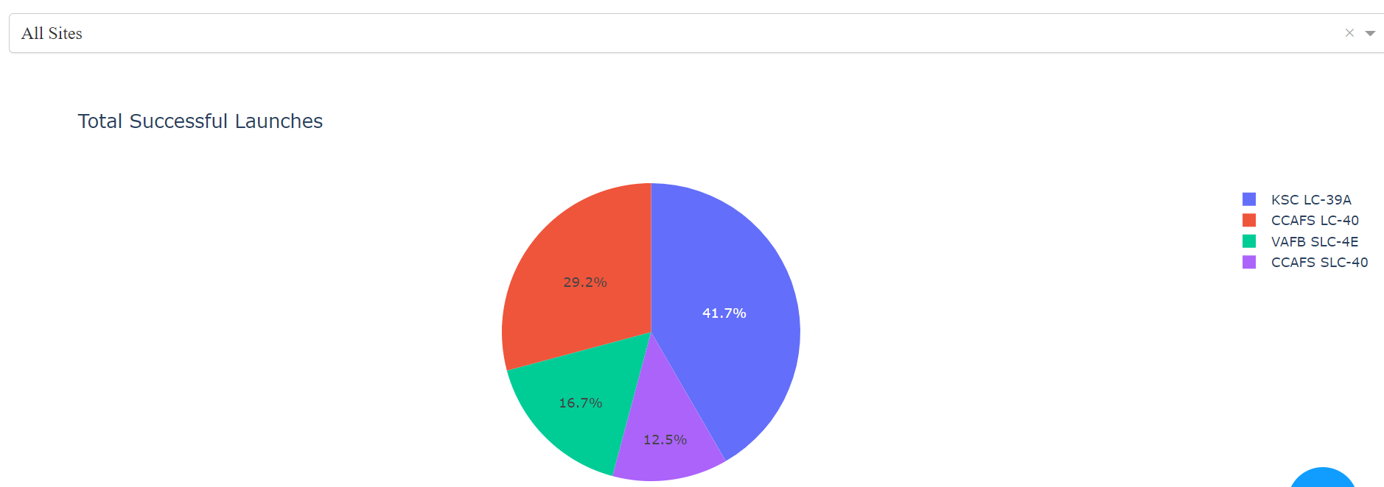
Launch Successes by Site Pie Chart
The below screenshot displays the proportion of total success by launch site. Specifically, distinguishing that the KSC LC-39A Launch site has experienced the most successes at 41.7% of all successes and that the CCAFS SLC-40 launch site has experienced the least number of successes with 12.5% of total successes

Slide 40
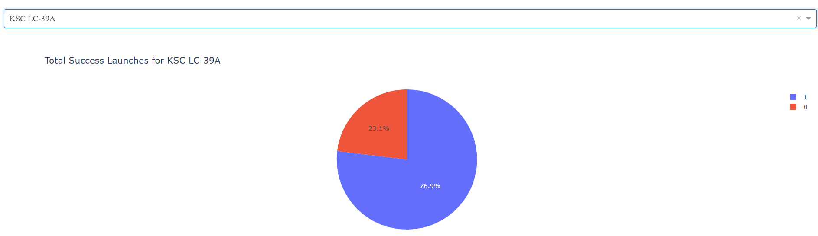
KSC LC-39A Success/Failure Rate Pie Chart
The below screenshot displays the proportion of successes and failures for all launches at the KSC LC-39A Launch site. Specifically, out of all launches at this Launch site 76.9% were successful and 23.1% failed, where 1 represents a success and 0 represents a failure.

Slide 41
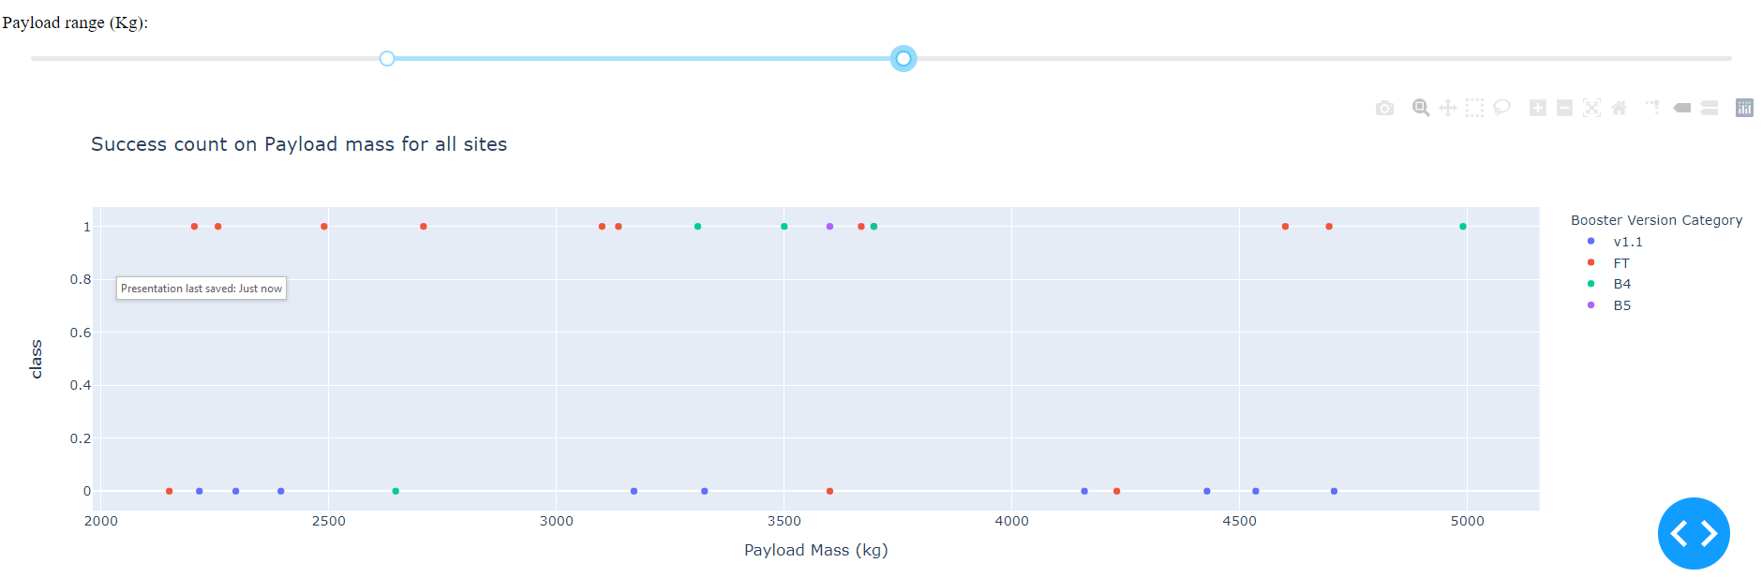
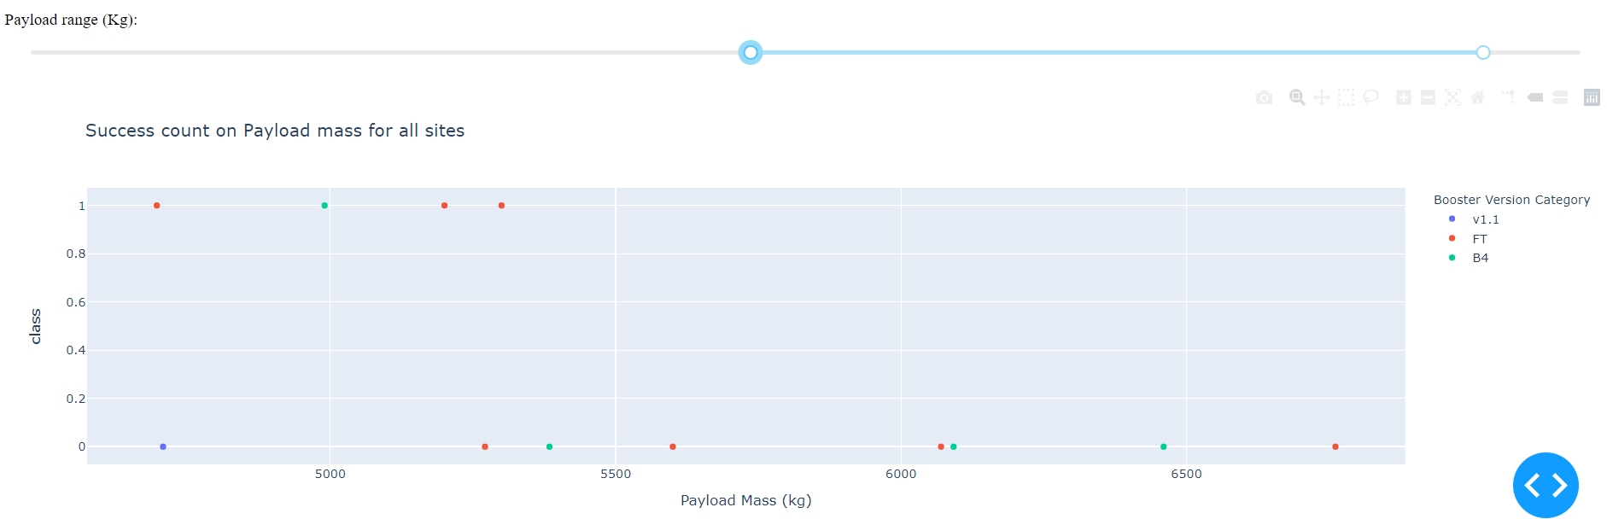
Multi-Range Payload vs. Launch Outcome Scatter Plot
The two screenshots adjacent show different payload ranges, the top screenshot showing a range of 2000kg to 5250kg and the bottom screenshot of 4750kg to 7000kg.
Booster Version FT has the most successes across both ranges.
The bottom screenshot depicts that heavier payload masses are less successful than the lighter payload masses depicted in the top screenshot.

Slide 42

Section 5

Slide 43
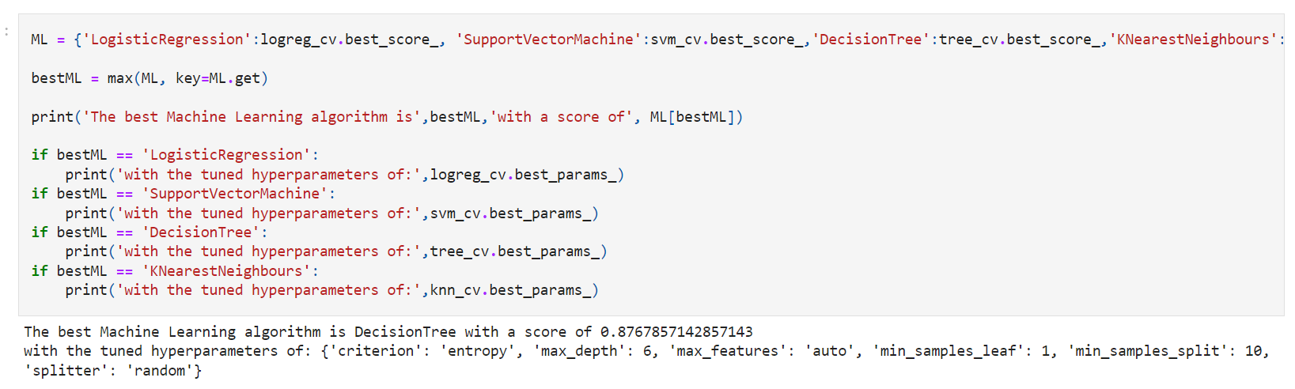
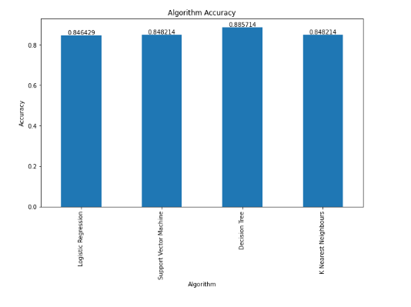
Classification Accuracy
The adjacent chart displays an accuracy result for each of the four algorithms applied to the SpaceX data
The model with the highest classification accuracy is the Decision Tree Model, specifically with the below Hyper-Parameters
{'criterion': 'entropy', 'max_depth': 4, 'max_features': 'auto', 'min_samples_leaf': 2, 'min_samples_split': 10, 'splitter': 'random'}

Slide 44
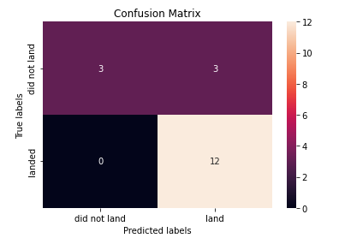
Confusion Matrix
The adjacent confusion matrix is the confusion matrix of the aforementioned Decision Tree model, which was the best performing model.
The Confusion Matrix states that the Decision Tree model has produced a three type 1 errors (False Positive) and no type 2 errors (False Negative), with recall of 1.0 and precision of 0.8.

Slide 45
Conclusions
From the analysis and investigations, it can be concluded that:
The larger the flight number at a launch site, the greater the success rate at that launch site
The most successful launch site of all the sites was, KSC LC-39A
Success rate generally increases over time, specifically from 2013 to 2020
The orbits with the highest success rate are ES-L1, GEO, HEO and SSO
The Decision Tree Model was the best machine learning classification model to predict future outcomes, specifically with tuned hyper parameters of {'criterion': 'entropy', 'max_depth': 4, 'max_features': 'auto', 'min_samples_leaf': 2, 'min_samples_split': 10, 'splitter': 'random’}
A future recommendation would be to apply other machine learning models to understand if there are better predictive models than the those used in this project

Slide 46
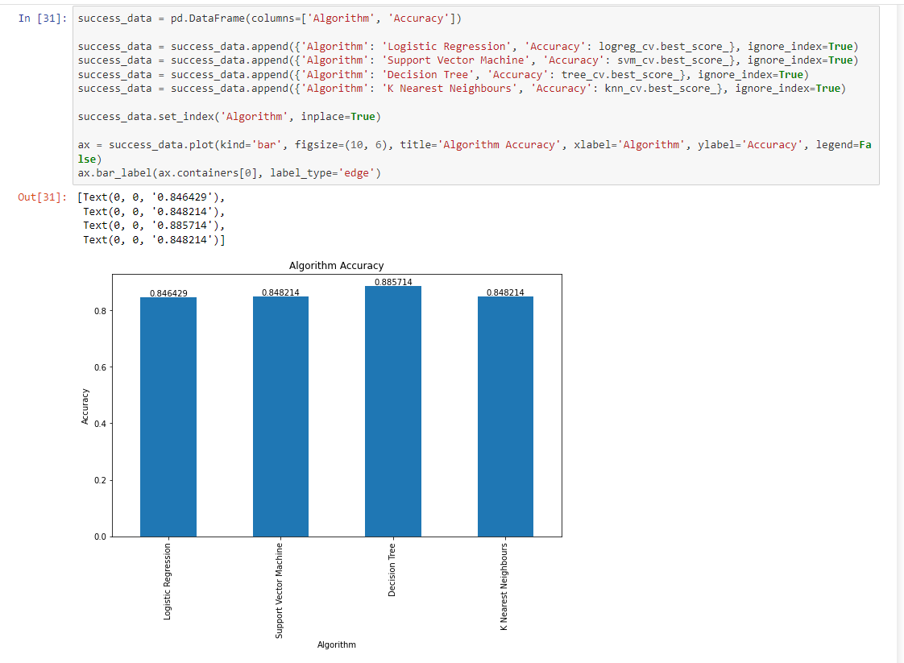
Appendix
Code written to show the Accuracy of each classification Algorithm used within the Machine Learning section

Slide 47


